Slide 1



Research Data Management: Roles and responsibilities
Sammy Khagayi

Slide 2
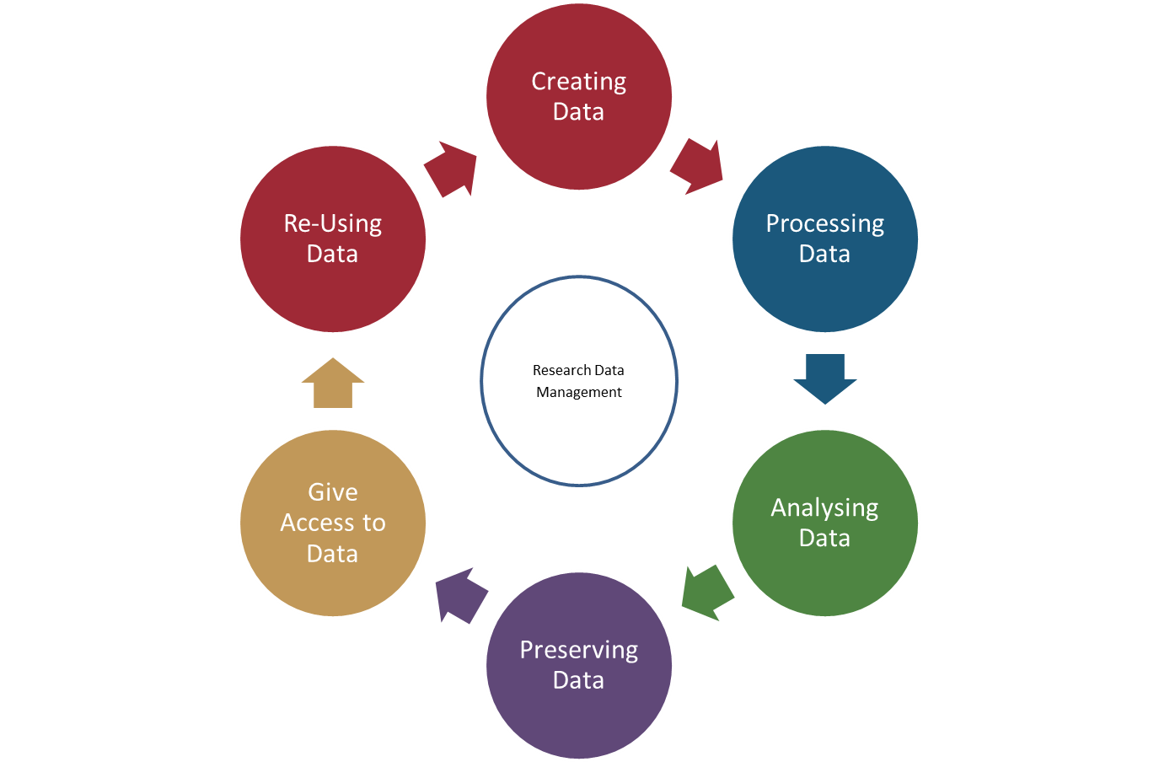
RDM cycle

Slide 3
RDM cycle
What are your roles at these stages?

Slide 4
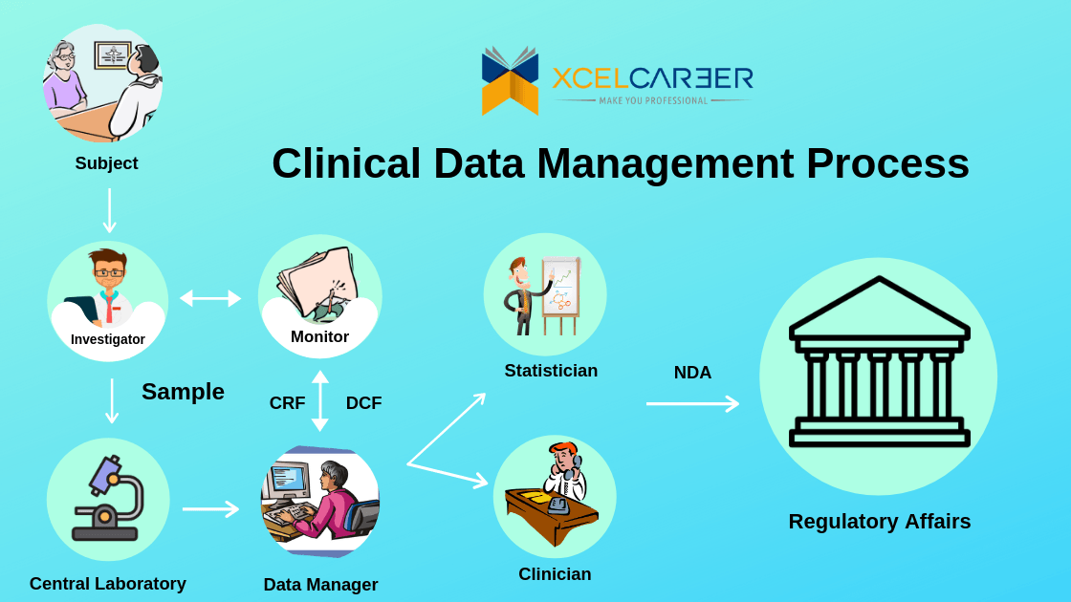



Slide 5
Research data is crucial as it is the evidence
base for your research findings

Slide 6

Research data is crucial as it is the evidence
base for your research findings

Slide 7
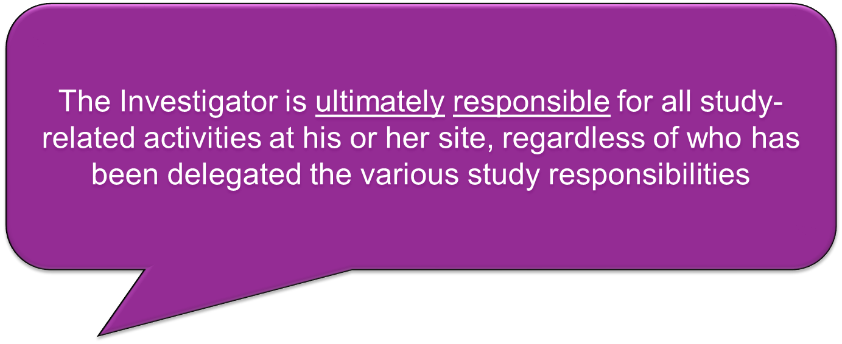
Roles and responsibilities: Researcher (Investigator)

Slide 8

Roles and responsibilities: Researcher
In charge of scientific input and output of the study/project
guarantees the integrity, quality, security and persistent availability of the collected or generated data
Overall guide, oversee and supervise research data management
Guides the writing of data management plan (DMP) according to regulations and procedures of the institution and study

Slide 9
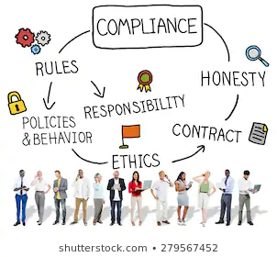

Roles and responsibilities: Researcher
In charge of the contractual, legal, ethical rules and regulations in relation to data management

Slide 10
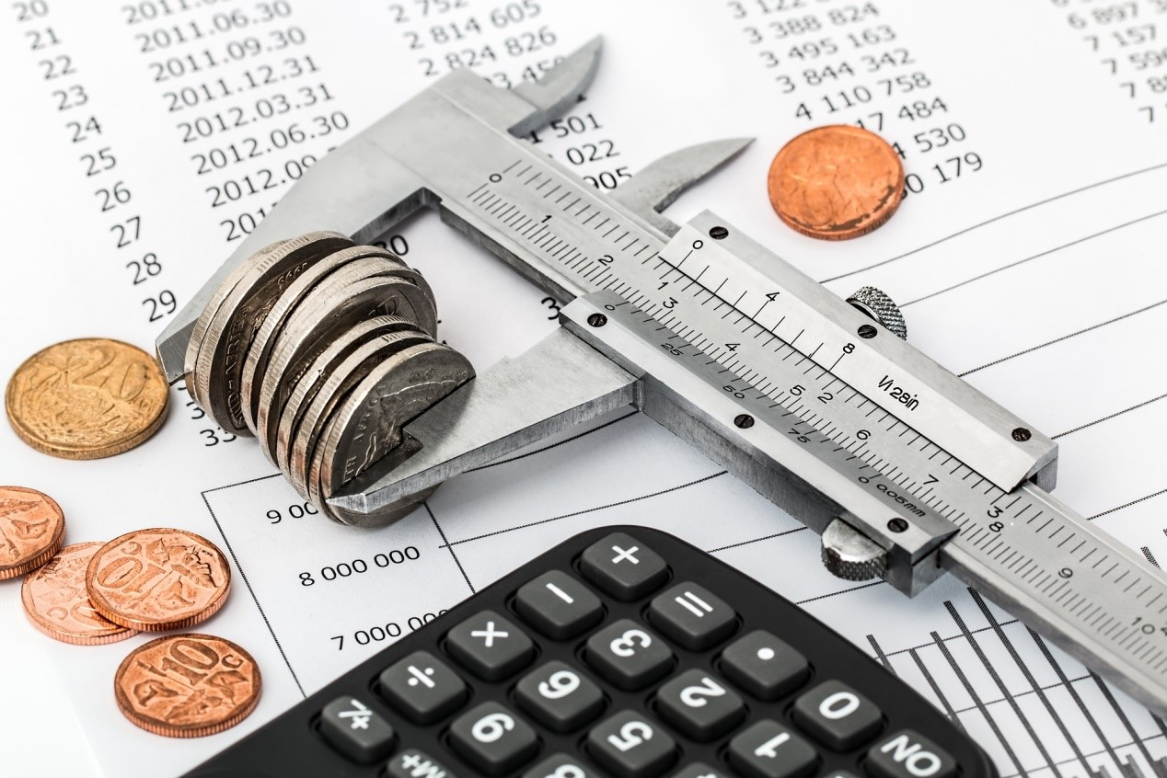
Roles and responsibilities: Researcher
Budgets the costs and time investment for data management and arranges the necessary resources, facilities and support for data management in the research
Ensure adequate number of qualified staff towards data management

Slide 11
Roles and responsibilities: Data Manager

Slide 12
Roles and responsibilities: Data Manager
A management role;
Ensure efficient, effective operation and usage of data
Responsible and answerable to the principal researcher or investigator

Slide 13
Roles and responsibilities: Data Manager
A management role;
Ensure efficient, effective operation and usage of data
Responsible and answerable to the principal researcher or investigator
GET INVOLVED FROM THE START!

Slide 14


Roles and responsibilities: Data Manager
OR

Slide 15

Roles and responsibilities: Data Manager
Ensure effective integration of Data Management processes with other processes in order to meet project/study level requirements
Create and enforce policies for effective data management
Acts as an interface to other research stakeholders (e.g. field staff, Ministry of Health, ICT managers)

Slide 16


Roles and responsibilities: Data Manager
Ensures compliance with data architecture and data management standards and procedures defined in the Data Management Framework
Monitors storage management information, standards, procedures, measurements, tools and technology

Slide 17

Roles and responsibilities: Data Manager
Troubleshoot data-related problems and authorize maintenance or modifications
Formulate techniques for quality data collection to ensure adequacy, accuracy and legitimacy of data
Monitor and analyze information and data systems and evaluate their performance to discover ways of enhancing them (new technologies, upgrades etc.)

Slide 18

Roles and responsibilities: Data Manager
Devise and implement efficient and secure procedures for data handling and analysis with attention to all technical aspects
Ensure digital databases and archives are protected from security breaches and data losses

Slide 19
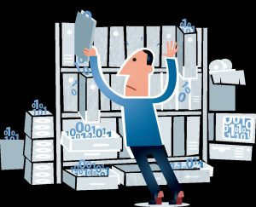
Roles and responsibilities: Data Manager
Establish rules and procedures for data sharing with upper management, external stakeholders etc.
Support others in the daily use of data systems and ensure adherence to legal and company standards
Assist with reports and data extraction when needed

Slide 20
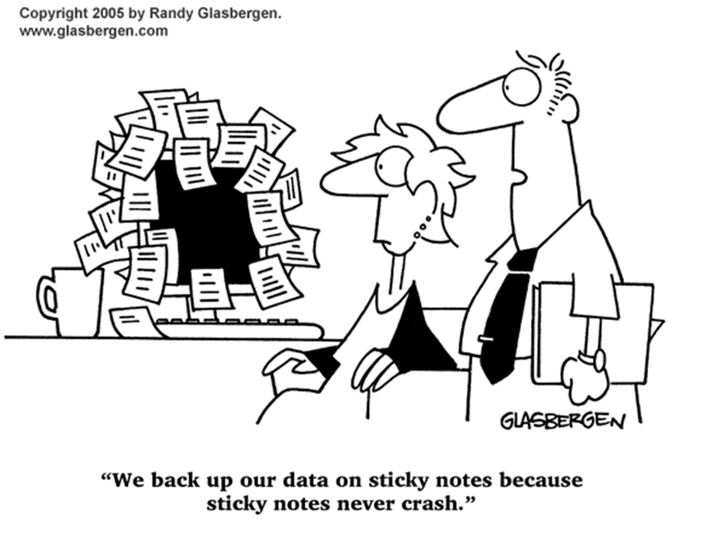
Roles and responsibilities: Data Manager
Manages the effective implementation of backup and restore procedures and working practices
Reviews backup and restore reports on a daily basis and monitors backup and restore information, standards, procedures, measurements, tools and technology

Slide 21

Roles and responsibilities: Data Manager
Communicates changes/modifications/enhancements regarding data management procedures, enhancement to backup and restore standards, staffing and technology

Slide 22
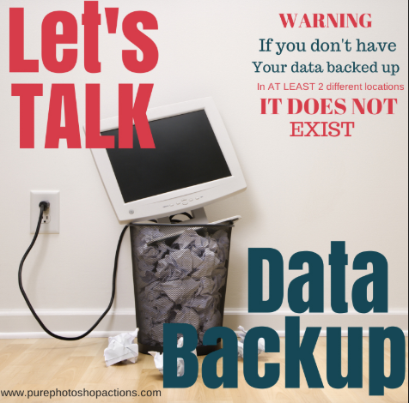

Slide 23
Acknowledgements

